Slide 1

Large Language Models and Retrieval Augmented Generation
Gerald Jones, 6/23/25​

Slide 2

Welcome & Objectives
Who:
My ASL TEAM!
What:
Brief overview of LLMs & RAG
Why:
Understanding Concepts Before some hands-on experimentation
Today’s goals:
Grasp LLM fundamentals
Understand What RAG is & how it works
See where RAG is useful
Get ready to build & test your own chatbot

Slide 3

Large Language Models
Application of Deep Learning
Pre-trained on massive text data
Predict text, answer questions, generate content
Examples: GPT-4, LLaMA, Mistral, GROK
Limitations: context window, hallucinations

Slide 4
Large Language Models
Mix of:
Encoder/Decoder
Temporal Predictors
Reinforcement Learning

Slide 5
Large Language Models
What they do:
Encode/Decode Information
Learn Probabilities
Generate Encoded Responses
Based on Probabilities

Slide 6

Why Use Retrieval?
LLMs are generalists: only know what they train on
May need up-to-date, domain-specific info
They can “read”, thus incorporate new knowledge
RAG = Combines retrieval + generation
Improves accuracy & relevance

Slide 7
Retrieval Augmented Generation (RAG)
🔍 Retrieve: Search docs for relevant chunks
🧠 Augment: Feed retrieved info to LLM
✍️ Generate: LLM writes the final answer using retrieved info

Slide 8
A visual
User
Input
Embedding Encoder
Embedding Vector Store
LLM
Retrieved Similar Documents
Response

Slide 9
Benefits of RAG
Up-to-date knowledge
Context-specific answers
Smaller LLMs can perform well when properly augmented
Better factuality, less hallucination

Slide 10
Typical RAG Workflow
process_pdfs_to_vector_store_and_embeddings()
Ingest documents: PDFs, text files → embeddings
Build vector store: Index documents by semantic meaning
Query: User asks a question
Retrieve: Top-matching chunks fetched
Generate: LLM uses context + question

Slide 11
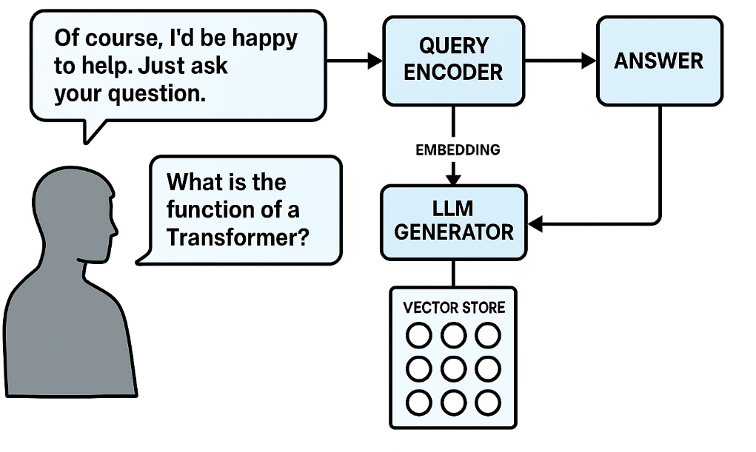
How to Make it Work?
Get Access to Your LLM
Find Relevant Documents
One to act as Chatbot
One for Embedding
Pick you knowledge domain
Find relevant Documents
Chunk & Store Documents
Set UP RAG Architecture
Use Embedding model
Chunk, Vectorize and Store
Set up framework to:
Query Vector Store
Retrieve Relevant Info
Pass to Chatbot
Retrieve Generated Results

Slide 12
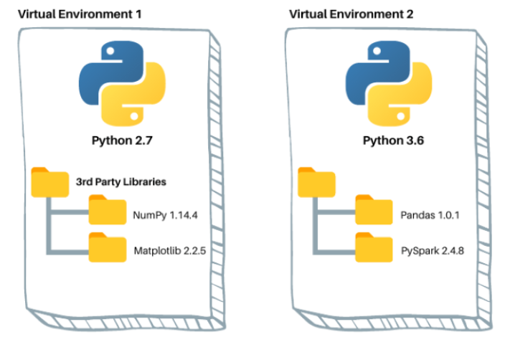
What we’ll Need
GPUs!!!!
Git Hub account
Access to Veridian
A new
Venv
kernel based on the former

Slide 13

What we will Do
Clone a repo
Create a setup venv & kernel
Set up some credentials
Play with a notebook

Slide 14
And Now, Lets Play!

Slide 18

Problem
Market gap
Customers
Financials
New businesses need organizational tools, but are using old or outdated products
10% increase of task management tools proves that there's consumer interest for more simple management tools and technology
Purchases of task management software was up by $2 million in 2019
Costs
Usability
Loss of sales by not offering easier management tools that push teams to the finish line
Customers want something that’s easy to adopt and simple to use

Slide 19
Solution
Close the gap
Target audience
Our product makes managing tasks easier, and no other product on the market offers the same benefits
Gen Z (18-25 years old)
Cost savings
Easy to use
Reduce costs for client by helping project managers stay on target within deadlines
A simple product that gives businesses the information they need in order to complete projects on time

Slide 20




Product Overview
Unique
First to market
Tested
Authentic
Only product specifically dedicated to task management​
First beautifully designed product that's both stylish and functional
Conducted testing with start ups in the area
Designed with the help and input of software experts

Slide 21

Product benefits
Simple and efficient to use​
Quick customer service assistance​
Free 90-day trial for new customers​​

Slide 22

Company overview

Slide 23
Business Model
Research​
We based our research on market trends and software sales ​
Abstract​
We believe people need new management tools to help businesses achieve their OKRs​
Design​
Minimalist design and easy to use ​

Slide 24
Market overview
$3B
$2B
$1B
Opportunity to build​
Fully inclusive market​
Total addressable market​
Freedom to invent​
Selectively inclusive market​
Serviceable available market​
​
Few competitors​
Specifically targeted market​
Serviceable obtainable market​
​

Slide 25

Market Comparison
Opportunity to build​
Fully inclusive market​
Total addressable market​
Freedom to invent​
Selectively inclusive market​
Serviceable available market​
​
Few competitors​
Specifically targeted market​
Serviceable obtainable market​
​

Slide 26

Our competition
Contoso​
Competitors​
Our product is priced below that of other task management tools on the market​
Simple and easy to use app and website, compared to the complex tools of our competitors​
Affordability is the main draw for our consumers to our product​
Company A​ Product is more expensive​
Companies B & C ​ Product is expensive and inconvenient to use​
Companies D & E​ Product is affordable, but inconvenient to use

Slide 27
competition
Convenient
Contoso
A
Expensive​
Affordable
B
D
E
C
Inconvenient​

Slide 28
Growth strategy
How we’ll scale in the future​
Feb 20xx
May 20xx
Oct 20xx
Distribute the app to local start ups to help establish the product
Release the app to the general public and monitor press and regional market trends
Gather feedback from the start up community to expand availability of the product

Slide 29
Traction
Forecasting for success​
Key Metrics
Revenue by year
 | clients | orders | Gross avenue | Net revenue
20XX​ | 10​ | 1100​ | $10,000​ | $7,000​
20XX​ | 20​ | 200​ | $20,000​ | $16,000​
20XX​ | 30​ | 300​ | $30,000​ | $25,000​
20XX​ | 40​ | 400​ | $40,000​ | $30,000

Slide 30
Two-year action plan
Supply volunteers​
Run focus groups​
Gather feedback​
20XX
Jan
Feb
Mar
Apr
May
Jun
Jul
Aug
Sep
Oct
Nov
Dec
Test with start ups​
Regional launch​
Deliver to consumers​
20XX
Jan
Feb
Mar
Apr
May
Jun
Jul
Aug
Sep
Oct
Nov
Dec

Slide 31

Financials
 | Year 1 | Year 2 | year 3
Detailers​ | 5,000​ | 40,000​ | 160,000​ | ​
Users​ | 50,000​ | 400,000​ | 1,600,000​ | ​
Sales​ | 500,000​ | 4,000,000​ | 16,000,000​ | ​
Average Price per Sale​ | 75​ | 80​ | 90​ | ​
Revenue @ 15%​ | 5,625,000​ | 48,000,000​ | 216,000,000​ | ​
Gross Profit​ | 5,625,000​ | 48,000,000​ | 216,000,000​ | ​
Expenses​ | ​ | ​ | ​ | ​
Sales & Marketing​ | 5,062,500​ | 38,400,000​ | 151,200,000​ | ​
Customer Service​ | 1,687,500​ | 9,600,000​ | 21,600,000​ | 70%​
Product Development​ | 562,500​ | 2,400,000​ | 10,800,000​ | 10%​
Research​ | 281,250​ | 2,400,000​ | 4,320,000​ | 5%​
Total Expenses​ | 7,593,750​ | 52,800,000​ | 187,920,000​ | 2%​

Slide 32




Meet the team
Takuma Hayashi​​
Mirjam Nilsson​​
Flora Berggren​​
Rajesh Santoshi​​
President​
Chief Executive Officer​
Chief Operations Officer​
VP Marketing​

Slide 33








The Full team
Takuma Hayashi​
Mirjam Nilsson​​
Flora Berggren​​
Rajesh Santoshi​​
President​
Chief Executive Officer​
Chief Operations Officer​
VP Marketing​
Graham Barnes​
Rowan Murphy​
Elizabeth Moore​
Robin Kline​
VP Product​
SEO Strategist​
Product Designer​
Content Developer​

Slide 34
Funding
$12K
$14K
$32K
$82K
Campaigns
Angel investments
Cash
Shares
Revenue obtained from online campaigns and reorders
Amount obtained through other investors​
Liquid cash we have
on hand​
Number of shares converted into USD​

Slide 35

Summary
At Contoso, we believe in giving 110%. By closing the loop on task management and using the latest technology, we help businesses grow and nurture a consumer-first mindset. We thrive because of our market knowledge and a great team behind our product. As our CEO says, "Efficiencies will come from proactively transforming how we do business."

Slide 36

Thank you
Mirjam Nilsson​​
206-555-0146​
mirjam@contoso.com​
www.contoso.com​

